Slide 1
Mobile Technology
Today and Tomorrow
Vic A. Berger
Technologist
Manager, Sales – Business Development
CDW Government, Inc.

Slide 2
Agenda
Mobility vs. Remote Operations
The Ultimate Road Warrior – Field Operations
The Ultimate Desktop – Telework
Emergency Alerts
Best Practices
Questions

Slide 3
Mobility vs. Remote Operations
Mobility: The ability to work from any location, at any time
Remote Operations: The ability to continue business operations from a secondary location in the event of a major disruption
Technology is the foundation of both mobility and remote operations

Slide 4
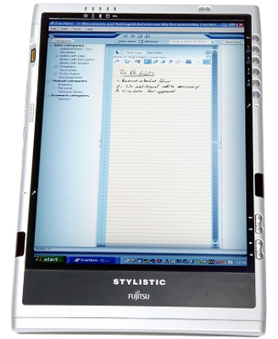
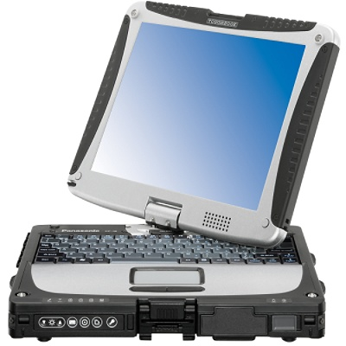
The Ultimate Road Warrior – Field Operations
Field Worker
  Tablets and handhelds
  Rugged hardware
  WiMax and WiFi
Business Traveler
  Laptops and handhelds
  SSL VPN
Continuity of Operations

Slide 5

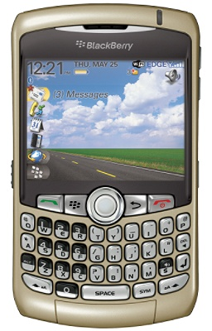
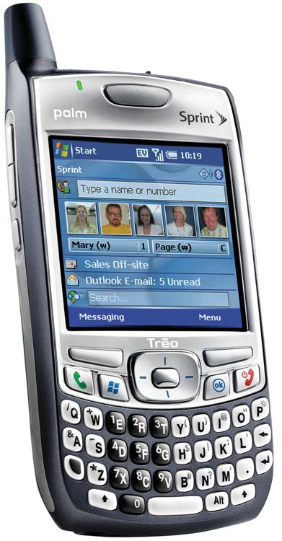
The Ultimate Road Warrior –
Future Tech
Wireless USB
Wireless power
Multi-function integration, smaller package
  Integrated Functions – GPS, Web, Mutimedia
  Full function PDA – Treo, Ipaq, Blackberry
  Hybrids – OQO and Samsung Q1

Slide 6
The Ultimate Desktop – Telework
Telework/Remote Office
  Laptops and handhelds
  SSL VPN
  Peer-to-peer collaboration software
  Videoconferencing
Workflow Efficiency
  Multifunction devices
  PDFs, not paper

Slide 7
The Ultimate Desktop –
Future Tech
Less wires
Unified communications
Optical character recognition
Multi-function devices converting documents to PDF
Personal backup, archival solutions
Green technology

Slide 8
Emergency Alerts
Media consumption habits are changing: We watch less TV, are more mobile and are increasingly reliant on cell phones and text messaging
Yet local governments primarily rely on radio and TV to communicate emergency information. Both require citizens to actively “tune in”

Slide 9
Emergency Alerts
28 billion text messages were sent in June 2007, up 130 percent from June 2006
Text messaging, radio and TV offer the greatest speed and depth of information, but only text messaging does not require citizens to act
A layered Continuity of Operations communication strategy should include the means to “push” targeted emergency information to constituents, regardless of their location

Slide 10
Best Practices
KISS
Mobility = Remote Operations
Use Your Refresh Cycle
Alternate Connectivity
Remote Admin EVERYTHING!
BC/DR/COOP as a Benefit, Not a Need

Slide 11
Questions?
Vic Berger
CDW Government, Inc.
vic.berger@cdwg.com

